Slide 1

DESIGN AND ANALYSIS OF ALGORITHMS (113939)
Dr. Owais Hussain

Slide 2

Agenda
Prime Numbers (yet again)
Algorithm Optimization
Mathematical Techniques
Approximation Methods
Data Structures
Dynamic Programming Methods
Parallelization Methods
Edge-case Filtration

Slide 3
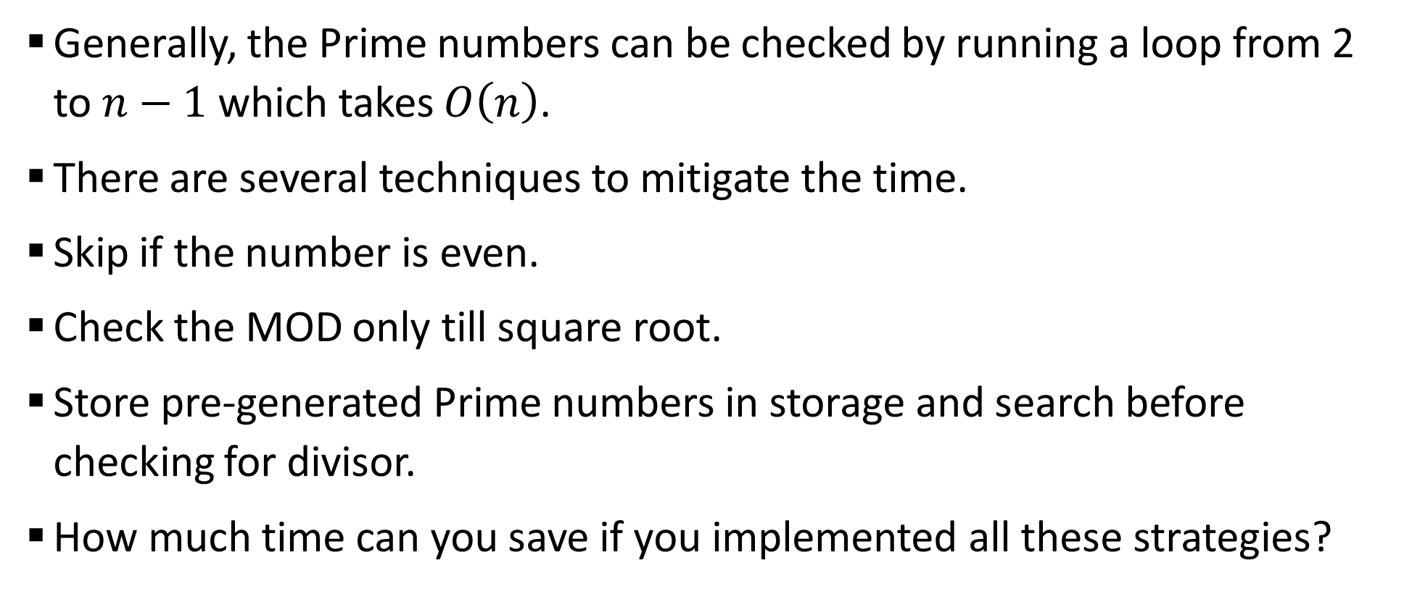
Sample 2
Prime Numbers (yet again)
Generally, the Prime numbers can be checked by running a loop from 2 to $n−1$ which takes $O\left(n\right)$.
There are several techniques to mitigate the time.
Skip if the number is even.
Check the MOD only till square root.
Store pre-generated Prime numbers in storage and search before checking for divisor.
How much time can you save if you implemented all these strategies?

Slide 4
Sample 2
Algorithm Optimization
Algorithm optimization refers to minimizing time or space that an algorithm takes to solve a problem.
There are two pre-requisites to algorithm optimization:
An existing algorithm which correctly solves the problem.
Time or Space complexity analysis based on the optimization objective.
Remember that we are not referring to code-level optimizations. The examples we will discuss are applicable on all types of computers and programming languages.

Slide 5
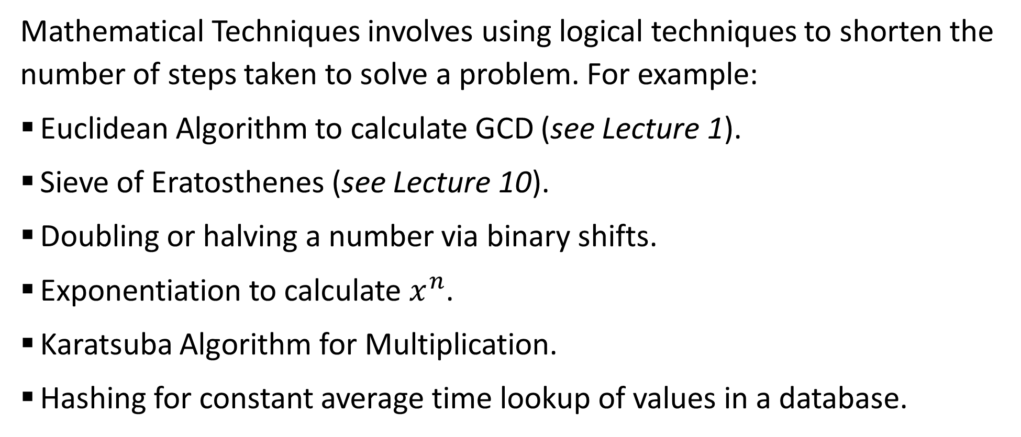
Sample 2
Mathematical Techniques
Mathematical Techniques involves using logical techniques to shorten the number of steps taken to solve a problem. For example:
Euclidean Algorithm to calculate GCD (see Lecture 1).
Sieve of Eratosthenes (see Lecture 10).
Doubling or halving a number via binary shifts.
Exponentiation to calculate $x^{n}$.
Karatsuba Algorithm for Multiplication.
Hashing for constant average time lookup of values in a database.

Slide 6
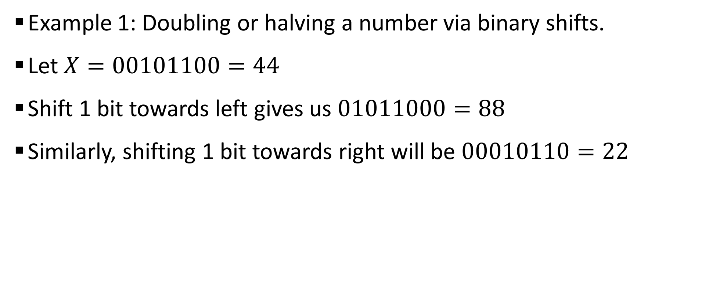
Sample 2
Mathematical Techniques
Example 1: Doubling or halving a number via binary shifts.
Let $X=00101100=44$
Shift 1 bit towards left gives us $01011000=88$
Similarly, shifting 1 bit towards right will be $00010110=22$

Slide 7
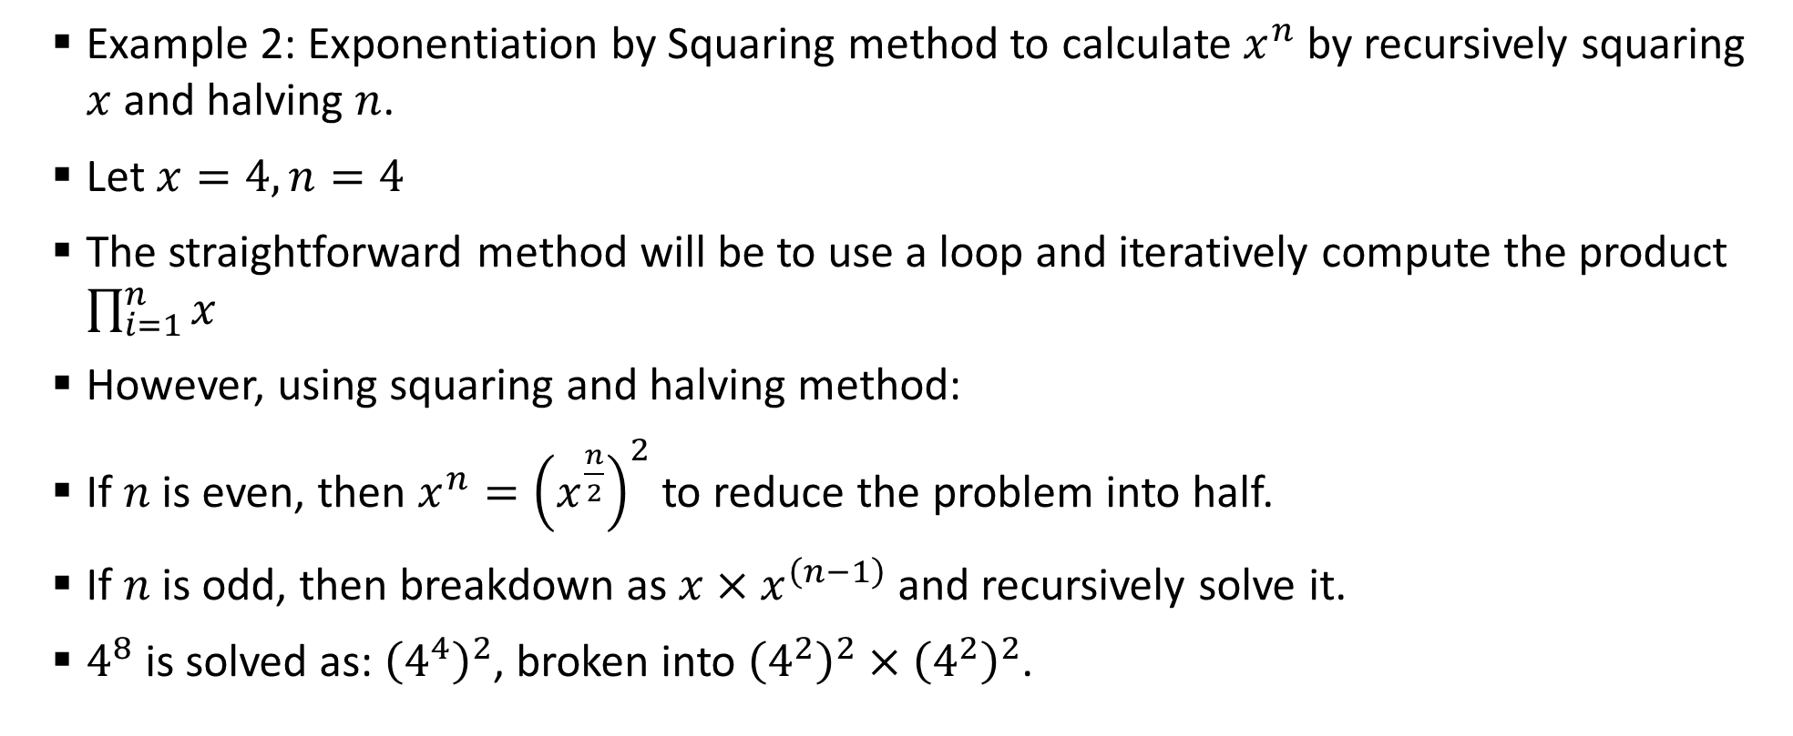
Sample 2
Mathematical Techniques
Example 2: Exponentiation by Squaring method to calculate $x^{n}$ by recursively squaring $x$ and halving $n$.
Let $x=4,n=4$
The straightforward method will be to use a loop and iteratively compute the product $\prod_{i=1}^{n}{x}$
However, using squaring and halving method:
If $n$ is even, then $x^{n}={\left(x^{\frac{n}{2}}\right)}^{2}$ to reduce the problem into half.
If $n$ is odd, then breakdown as $x×x^{\left(n−1\right)}$ and recursively solve it.
$4^{8}$ is solved as: ${\left(4^{4}\right)}^{2}$, broken into ${\left(4^{2}\right)}^{2}×{\left(4^{2}\right)}^{2}$.

Slide 8
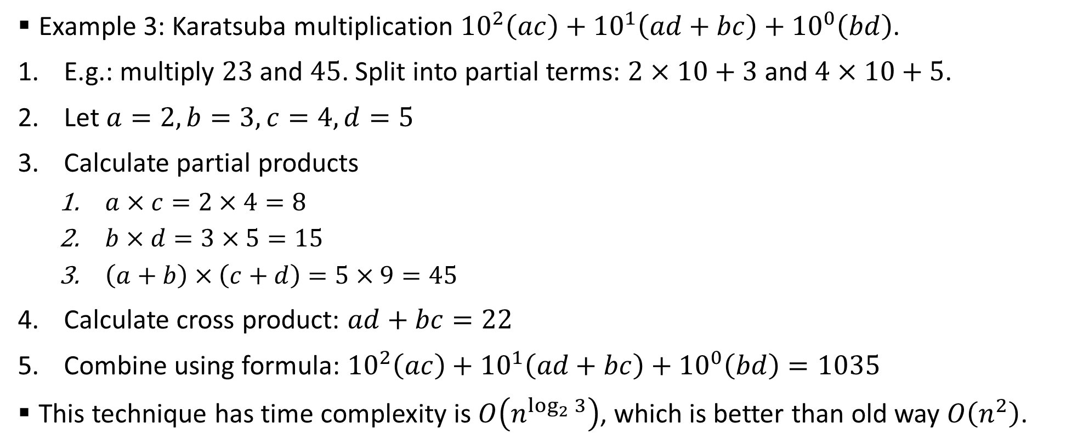
Sample 2
Mathematical Techniques
Example 3: Karatsuba multiplication ${10}^{2}\left(ac\right)+{10}^{1}\left(ad+bc\right)+{10}^{0}\left(bd\right)$.
E.g.: multiply $23$ and $45$. Split into partial terms: $2×10+3$ and $4×10+5$.
Let $a=2,b=3,c=4,d=5$
Calculate partial products
$a×c=2×4=8$
$b×d=3×5=15$
$\left(a+b\right)×\left(c+d\right)=5×9=45$
Calculate cross product: $ad+bc=22$
Combine using formula: ${10}^{2}\left(ac\right)+{10}^{1}\left(ad+bc\right)+{10}^{0}\left(bd\right)=1035$
This technique has time complexity is $O\left(n^{\log_{2}{3}}\right)$, which is better than old way $O\left(n^{2}\right)$.

Slide 9
Sample 2
Approximation Methods
Approximation means limiting to a solution that is closest to the accurate value. For example:
Approximate value of PI.
Heron’s square root approximation.
Matrix Inverse Approximation.

Slide 10
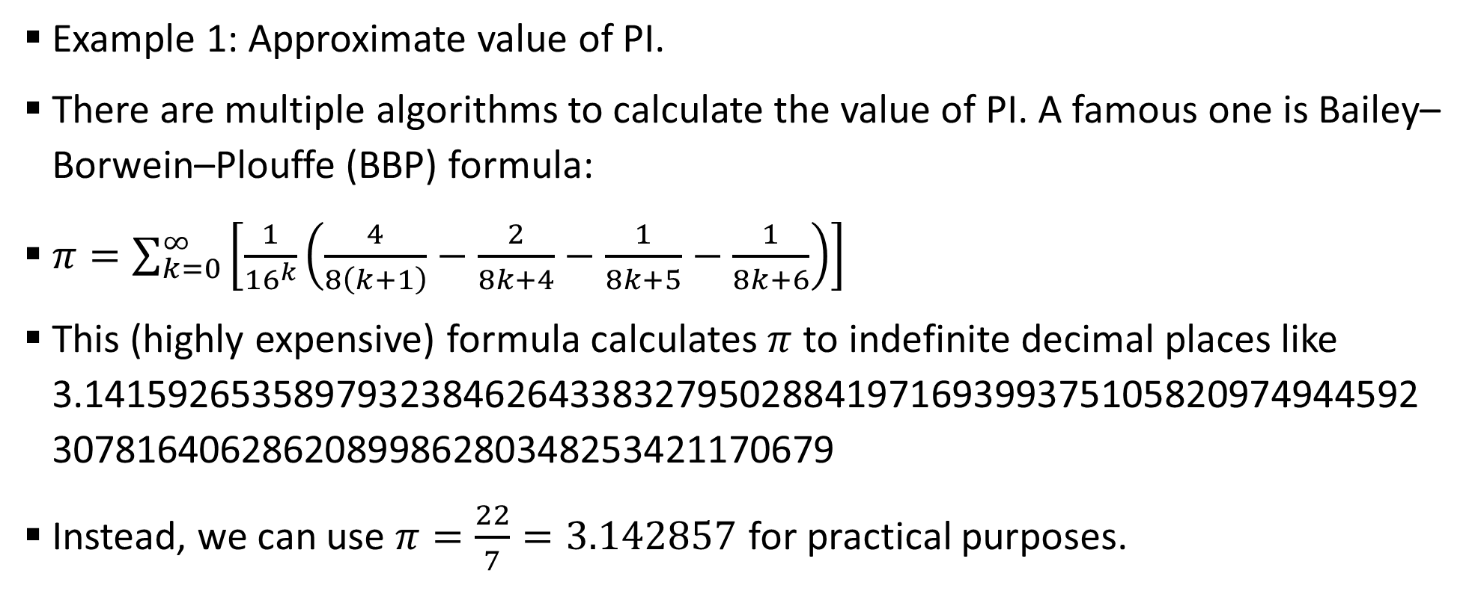
Sample 2
Approximation Methods
Example 1: Approximate value of PI.
There are multiple algorithms to calculate the value of PI. A famous one is Bailey–Borwein–Plouffe (BBP) formula:
$π=\sum_{k=0}^{∞}{\left[\frac{1}{{16}^{k}}\left(\frac{4}{8\left(k+1\right)}−\frac{2}{8k+4}−\frac{1}{8k+5}−\frac{1}{8k+6}\right)\right]}$
This (highly expensive) formula calculates $π$ to indefinite decimal places like 3.1415926535897932384626433832795028841971693993751058209749445923078164062862089986280348253421170679
Instead, we can use $π=\frac{22}{7}=3.142857$ for practical purposes.

Slide 11
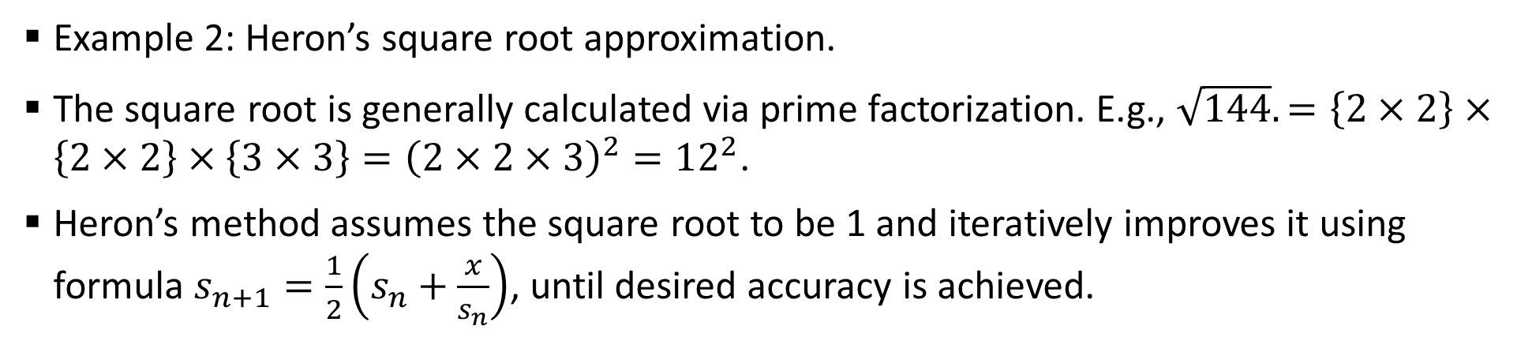
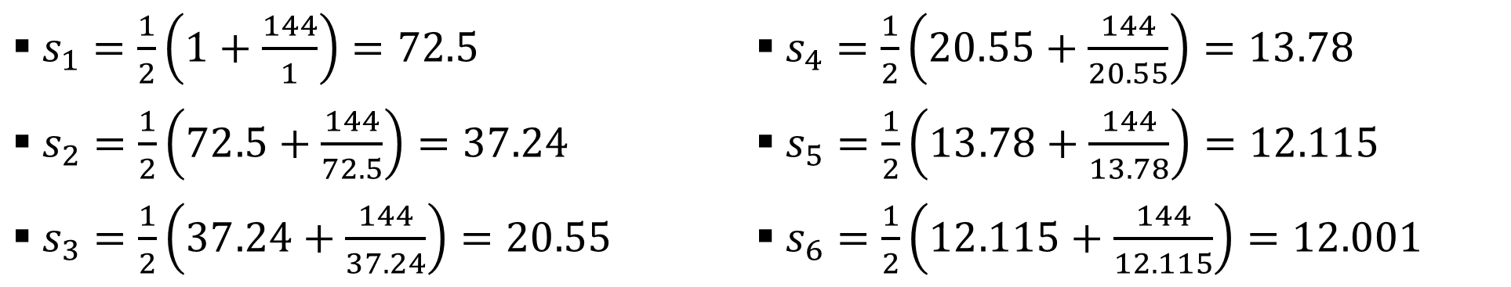
Sample 2
Approximation Methods
Example 2: Heron’s square root approximation.
The square root is generally calculated via prime factorization. E.g., $\sqrt{144}.=\left\{2×2\right\}×\left\{2×2\right\}×\left\{3×3\right\}={\left(2×2×3\right)}^{2}={12}^{2}$.
Heron’s method assumes the square root to be 1 and iteratively improves it using formula $s_{n+1}=\frac{1}{2}\left(s_{n}+\frac{x}{s_{n}}\right)$, until desired accuracy is achieved.
$s_{1}=\frac{1}{2}\left(1+\frac{144}{1}\right)=72.5$
$s_{2}=\frac{1}{2}\left(72.5+\frac{144}{72.5}\right)=37.24$
$s_{3}=\frac{1}{2}\left(37.24+\frac{144}{37.24}\right)=20.55$
$s_{4}=\frac{1}{2}\left(20.55+\frac{144}{20.55}\right)=13.78$
$s_{5}=\frac{1}{2}\left(13.78+\frac{144}{13.78}\right)=12.115$
$s_{6}=\frac{1}{2}\left(12.115+\frac{144}{12.115}\right)=12.001$

Slide 12
Sample 2
Data Structures
Selecting right data structure involves learning about the problem thoroughly. For example:
Stack for Prefix (Polish) and Postfix notations.
Linear Array for fixed-sized set of values.
Heaps for sorted record-keeping (see lecture 11).
Doubly Linked-List to implement Undo-Redo and thread scheduling.

Slide 13
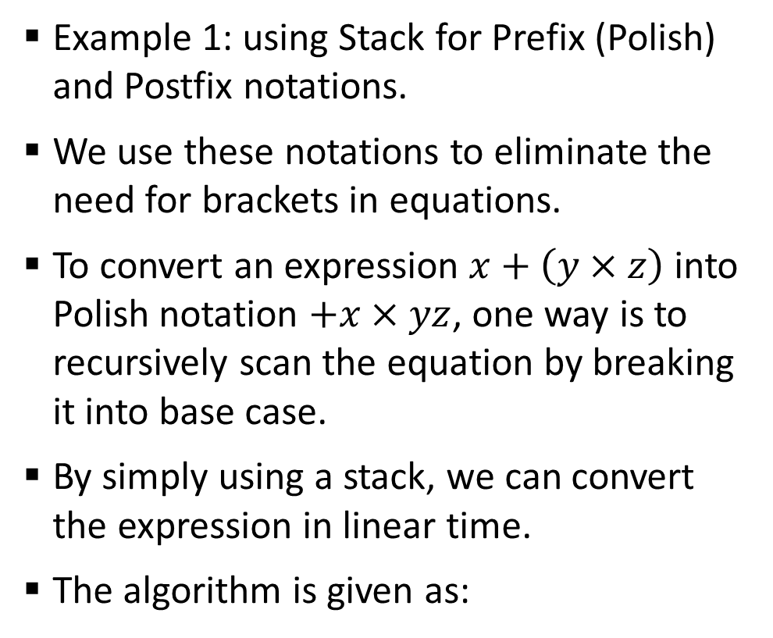
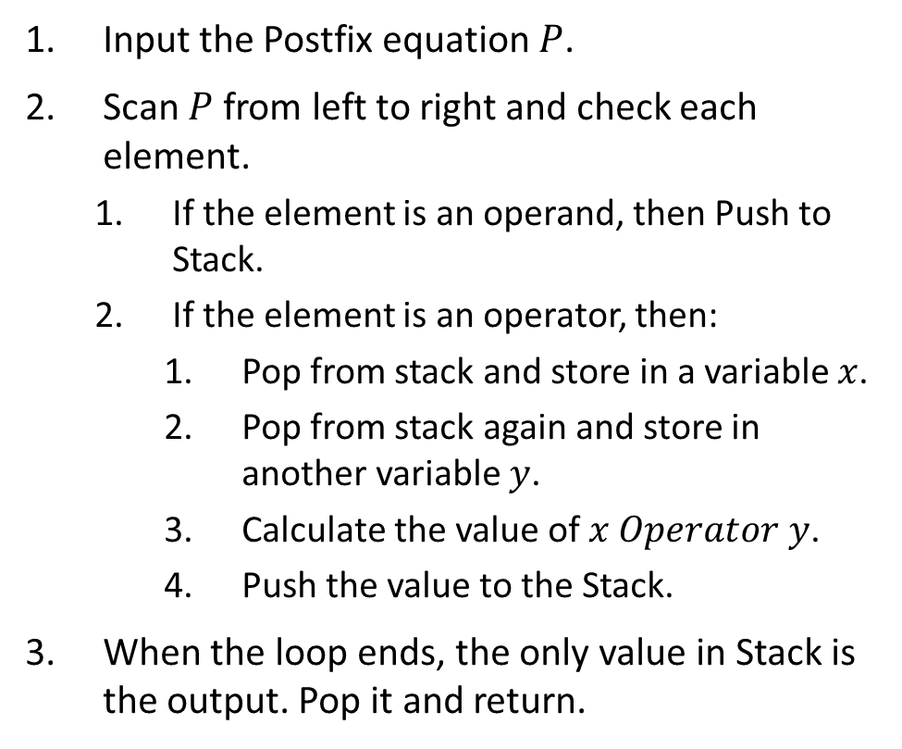
Sample 2
Data Structures
Example 1: using Stack for Prefix (Polish) and Postfix notations.
We use these notations to eliminate the need for brackets in equations.
To convert an expression $x+\left(y×z\right)$ into Polish notation $+x×yz$, one way is to recursively scan the equation by breaking it into base case.
By simply using a stack, we can convert the expression in linear time.
The algorithm is given as:
Input the Postfix equation $P$.
Scan $P$ from left to right and check each element.
If the element is an operand, then Push to Stack.
If the element is an operator, then:
Pop from stack and store in a variable $x$.
Pop from stack again and store in another variable $y$.
Calculate the value of $x Operator y$.
Push the value to the Stack.
When the loop ends, the only value in Stack is the output. Pop it and return.

Slide 14
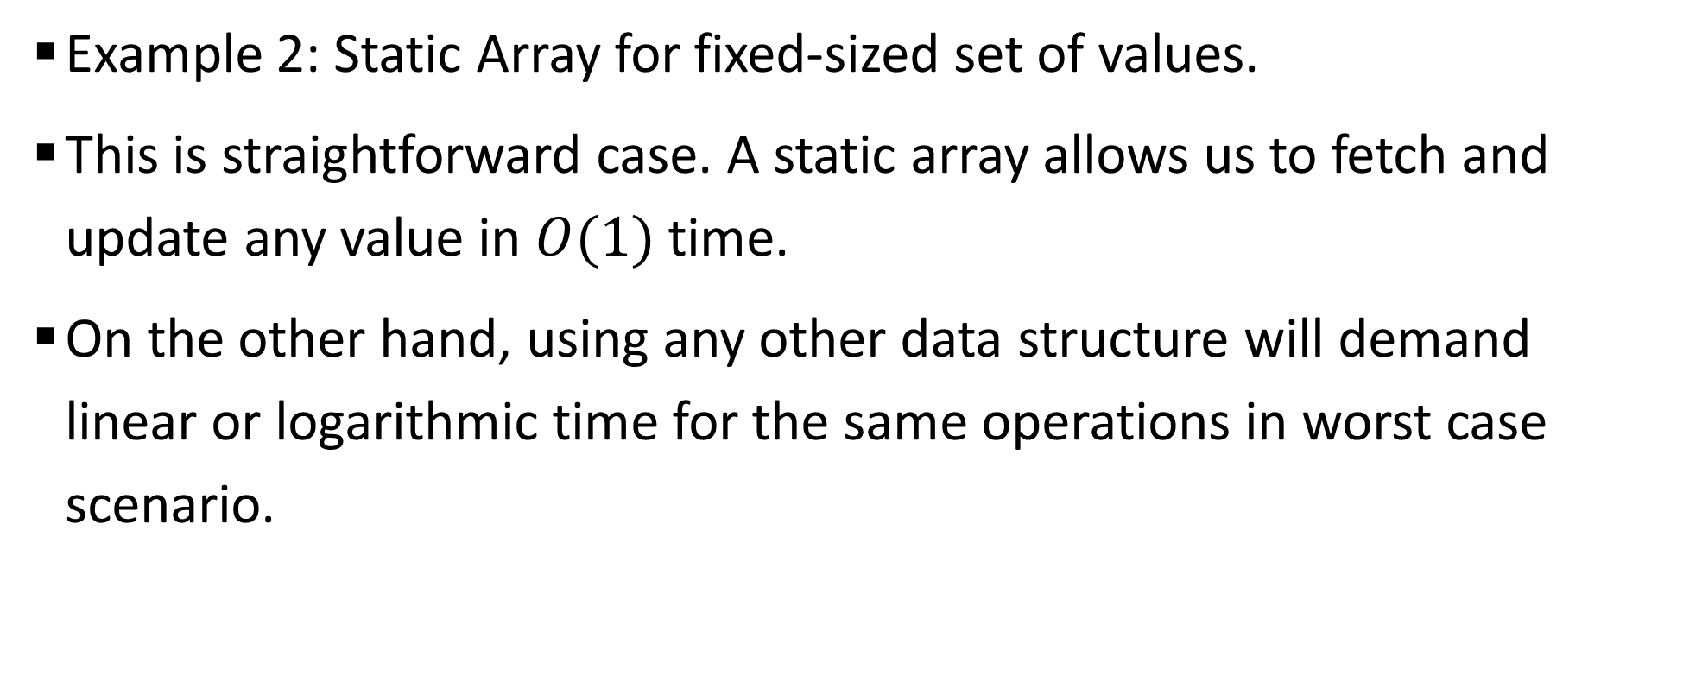
Sample 2
Data Structures
Example 2: Static Array for fixed-sized set of values.
This is straightforward case. A static array allows us to fetch and update any value in $O(1)$ time.
On the other hand, using any other data structure will demand linear or logarithmic time for the same operations in worst case scenario.

Slide 15
Sample 2
Dynamic Programming Methods
Dynamic Programming involves Memoization of solutions which have already been calculated to avoid re-computation. For example:
Knapsack problem
Shortest Path in a Graph
Matrix Chain Multiplication
Binomial Coefficient
Notes:
Memoization is the concept of using cache memory to eliminate redundant calculations.

Slide 16
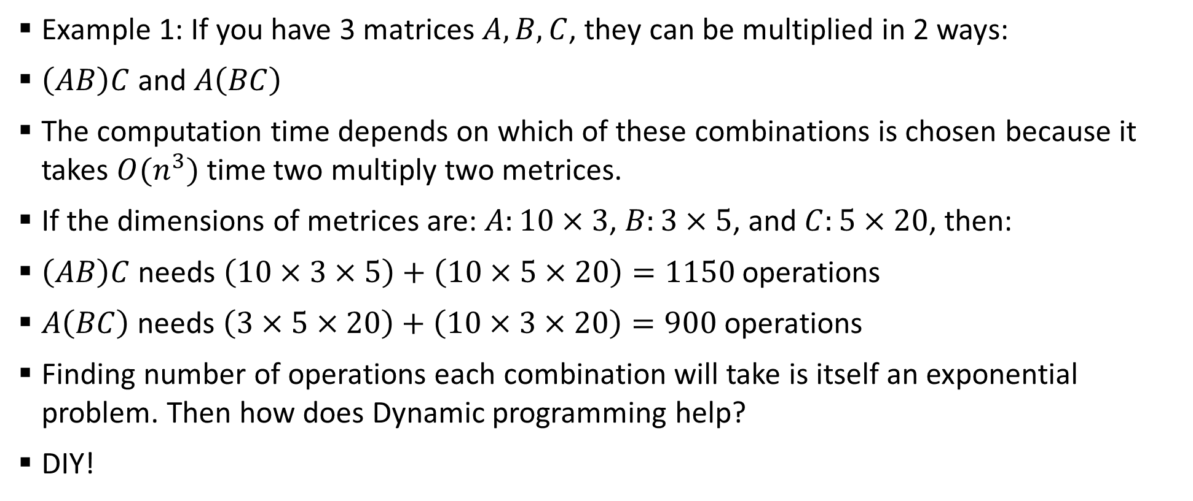
Sample 2
Dynamic Programming Methods
Example 1: If you have 3 matrices $A,B,C$, they can be multiplied in 2 ways:
$\left(AB\right)C$ and $A\left(BC\right)$
The computation time depends on which of these combinations is chosen because it takes $O(n^{3})$ time two multiply two metrices.
If the dimensions of metrices are: $A:10×3$, $B:3×5$, and $C:5×20$, then:
$\left(AB\right)C$ needs $\left(10×3×5\right)+\left(10×5×20\right)=1150$ operations
$A\left(BC\right)$ needs $\left(3×5×20\right)+\left(10×3×20\right)=900$ operations
Finding number of operations each combination will take is itself an exponential problem. Then how does Dynamic programming help?
DIY!

Slide 17
Sample 2
Dynamic Programming Methods
Example 2: Knapsack problem (see lecture 10)
Example 3: Shortest path in a Graph (see lecture 11, 12)

Slide 18
Sample 2
Parallelization Methods
Partitioning the problem into multiple chunks and using multiple computers to solve them independently. For example:
Word count problem.
Graphics rendering.
Search in a large database.
Machine Learning.
CAUTION! Parallelization does not work on problems that are recursive in nature.

Slide 19
Sample 2
Edge Case Filtration
Applying heuristics to identify obvious cases before pre-execution. For example:
Search for largest/smallest value in a sorted array.
Check if the array is already sorted before sorting.
Removing outliers from data.
Avoiding worst-case scenario in Quicksort.

Slide 20



THANK YOU
Owais Hussain
+92 345-3174270
owais.hussain@kiet.edu.pk
https://www.researchgate.net/profile/Owais-Hussain-3

